Slide 1
Implementing Conversational AI
-Presentation by
Group 05

Slide 2




Team Members:
Santosh Sekhar Muchkur Bogarajula
Lakshmi Seshu Kalvakuri
Shivani Busireddy
Srimai Reddy Yanala
Vijay Tupakula

Slide 3
Contents:
What is Conversational AI?
What fueled the rise of conversational AI?
Scope of Conversational AI
Most Trending AI device Technologies
Technologies Behind Conversational AI
Why Conversational AI?
Live Demo

Slide 4

What is conversational AI...?
Use of messaging apps, speech-based assistants and chatbots to automate communication and create personalized customer experiences at scale.
Image source: https://cdn-images-1.medium.com/max/918/1*avckxHOb81Zt-DueKRzxMQ.png

Slide 5
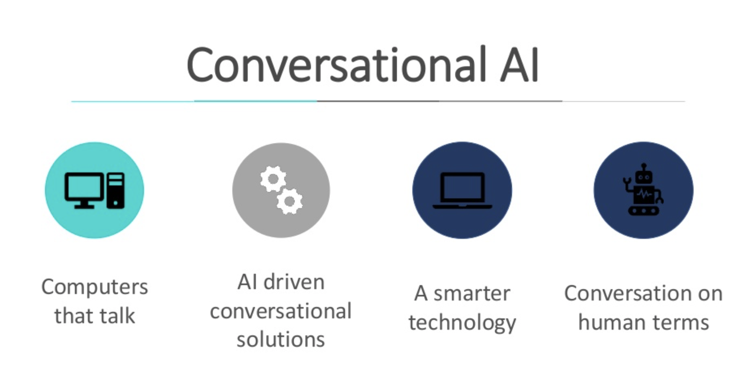

Slide 6
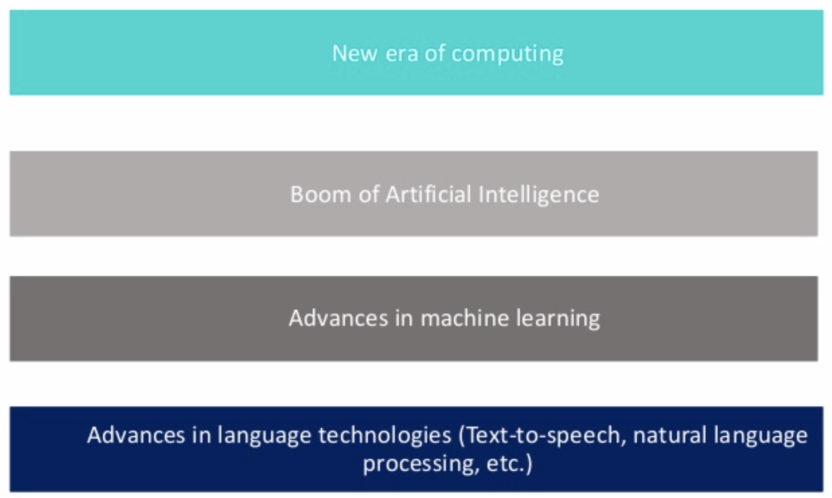
What fueled the rise of conversational AI?

Slide 7
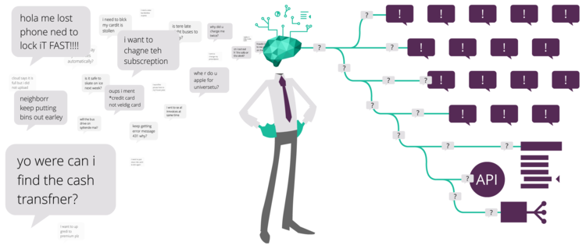
Image source: https://static1.squarespace.com/static/5a82e68c4c326d50016f26b5/t/5bc6f419f9619ab938278cf6/1539765285109/Six+ways.png?format=750w

Slide 8
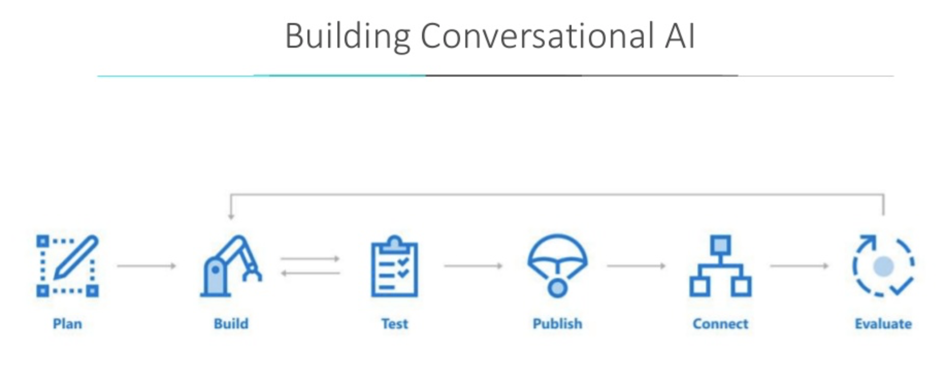
Image source: https://raw.githubusercontent.com/Microsoft/AI/master/docs/media/virtualassistant-diagram.jpg

Slide 9
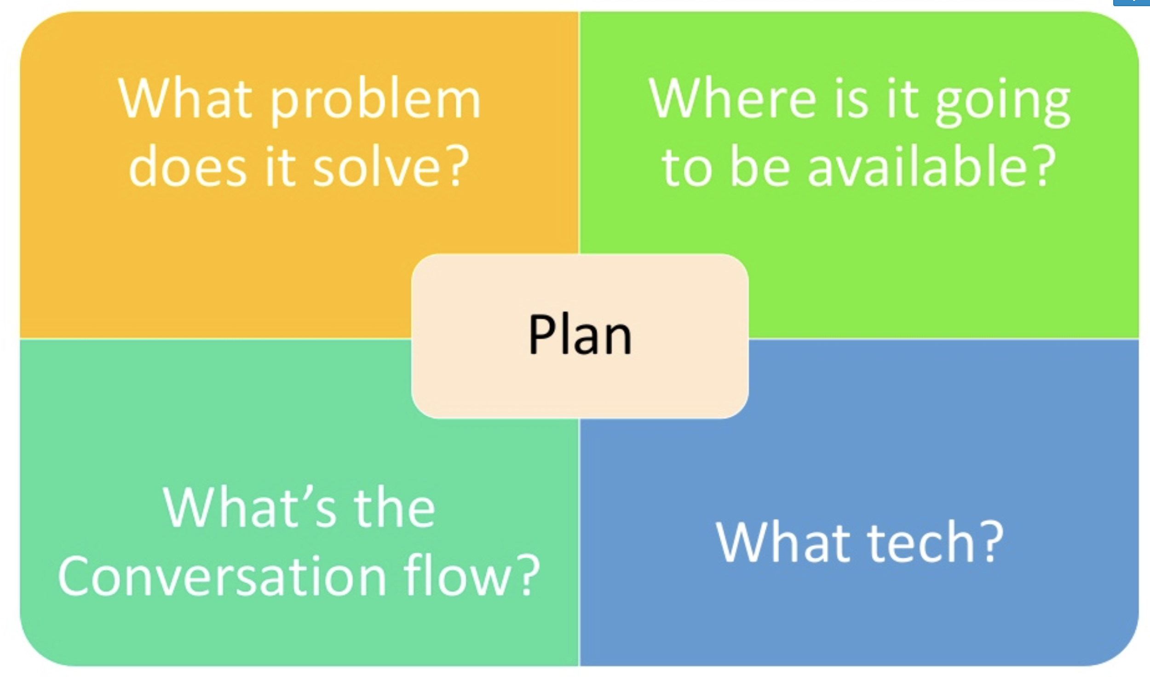

Slide 10

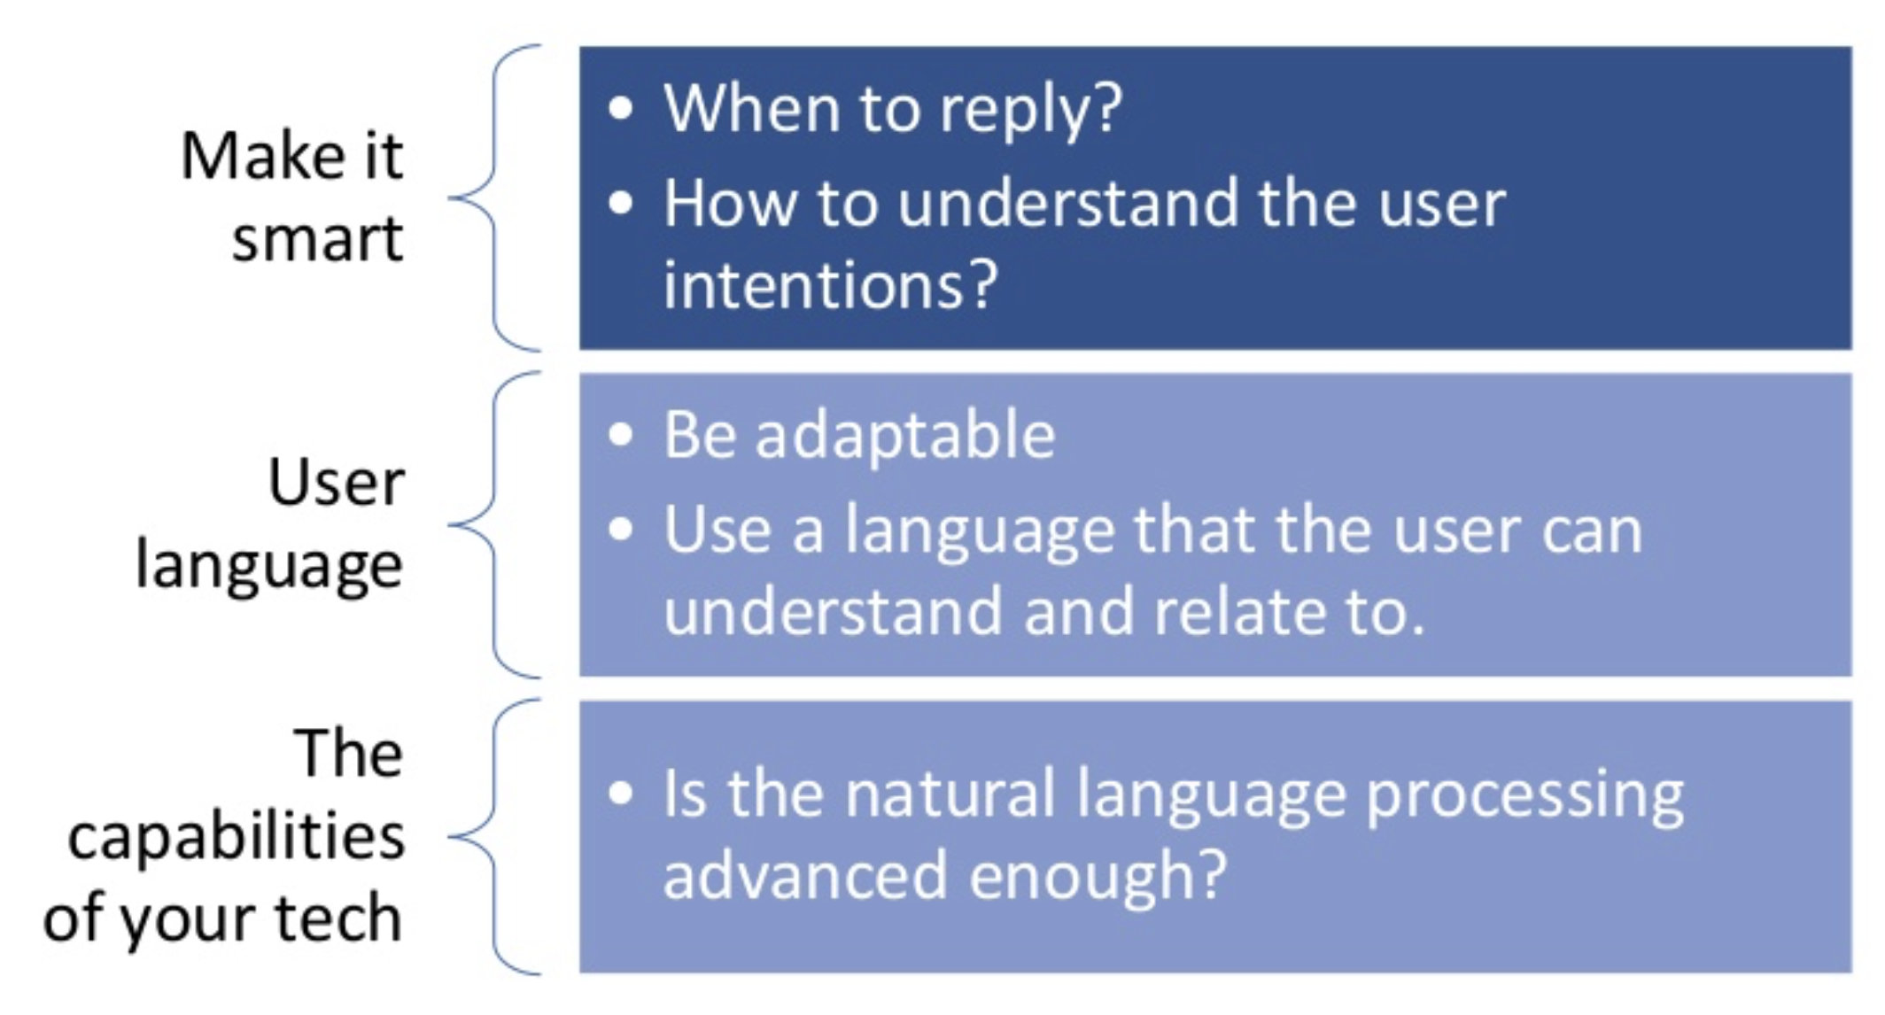
Things to be considered...
Image source: https://cdn.shopify.com/s/files/1/1061/1924/products/2_large.png?v=1544200552

Slide 11
Scope of AI
Virtual assistants can fill loneliness in one’s life!
Can be one’s entertainment system
Can be one’s remote control
HR Chatbots for employee onboarding
The scope of Chatbots in banking
Bots help eCommerce evolve

Slide 12

Scope of conversational AI

Slide 13

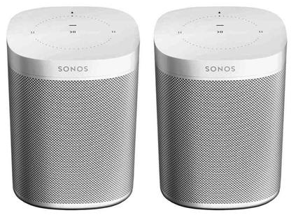
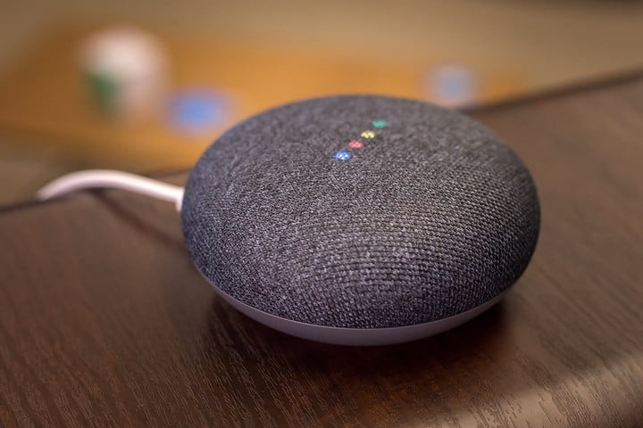
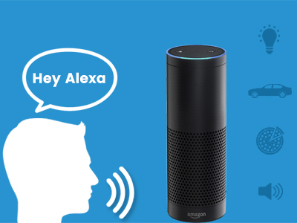
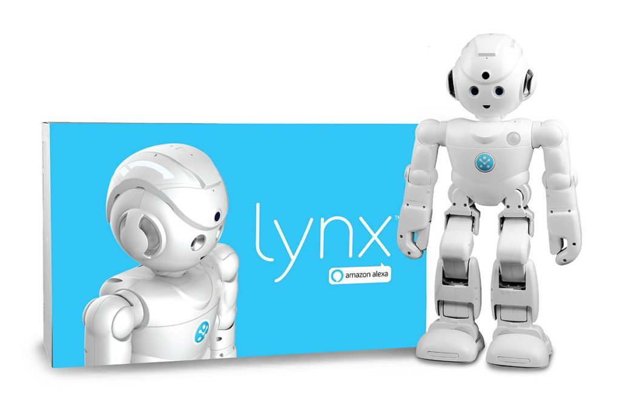
Most trending AI device technologies
Image source: https://static.seekingalpha.com/uploads/2017/1/30/47535815-14858323502251425_origin.jpg
Image source: https://images-na.ssl-images-amazon.com/images/I/81Sw1HOJRLL._SX425_.jpg
Image source: https://icdn2.digitaltrends.com/image/poster-for-5718044378001-720x720.jpg
Image source: https://cdn.dribbble.com/users/1726280/screenshots/5614445/revamp-alexa-skill-development.gif
Image source: https://cdn.vox-cdn.com/thumbor/aisDiXUogvfA9MwqTuJ_SzI5kkg=/0x0:1200x790/1200x800/filters:focal(504x299:696x491)/cdn.vox-cdn.com/uploads/chorus_image/image/57684283/61szJyIzjKL._SL1200_.0.jpg

Slide 14
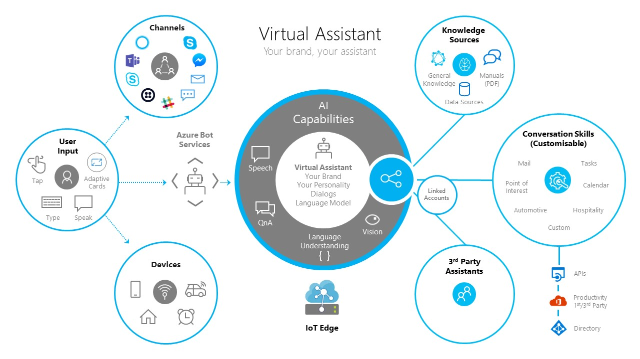
Image source: https://raw.githubusercontent.com/Microsoft/AI/master/docs/media/virtualassistant-diagram.jpg

Slide 15
Technology behind conversational AI
The AI behind the conversational functionality of such a platform can range from complex techniques like Machine Learning and Deep Learning to surface “layers” of the platform that rely on simple if-else chains to guide users through a flowchart.
Layer 1: Handle simpler exchanges through pre-built conversational flows that anticipate numerous possible cases.
Layer 2: A generative and “neural conversation model” that we use helps us cater to queries which the bot is usually not trained on.
Layer 3: Default to a Small Talk module that can handle random open-ended queries about the weather, etc.

Slide 16
Why conversational AI?
Delightful User experience
Its timely i.e. 24*7
Humans like to do things with less effort
Its engaging and conversational
Scalability: infinite
Easy communication
Talks only what is necessary and when asked for

Slide 17

Image source: https://www.promisec.com/wp-content/uploads/2016/09/livedemo-1.png

Slide 18

Questions...
Image source: https://static1.squarespace.com/static/585c5b5a9de4bb6fe48becb4/t/589bda1e20099ecd1ba5027a/1486608931886/

Slide 19
References
https://developer.amazon.com/alexa-skills-kit/conversational-ai
https://www.slideshare.net/rabebothmani/building-conversational-ai-133402381?qid=2820e335-d889-46ff-b492-176de489e0ef&v=&b=&from_search=2
https://www.iotforall.com/what-is-conversational-ai/
https://chatbotslife.com/https-medium-com-hellohaptik-understanding-conversational-ai-what-where-how-you-can-use-bots-a5df897886f9

Slide 20

Have a great Day.. :)
Image source: https://artiez.co.uk/wp-content/uploads/2018/12/Thank-You-Free-PNG-Image.png

